Slide 1

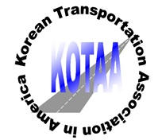
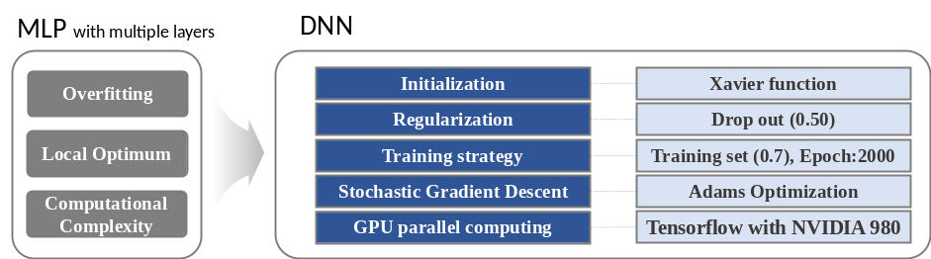
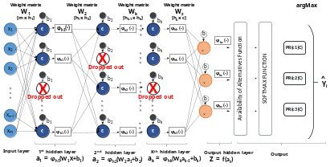
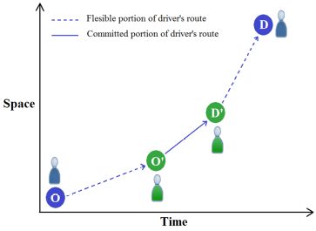
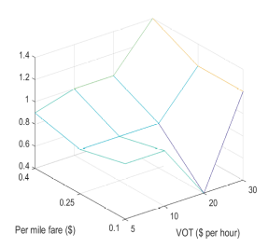
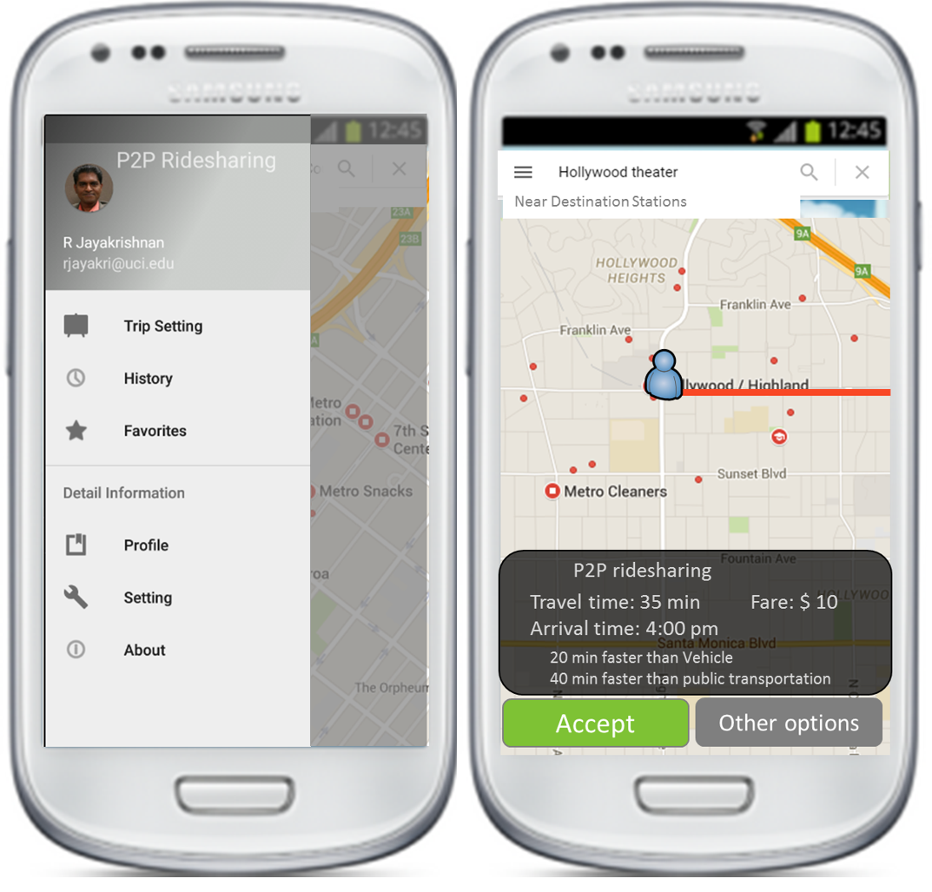
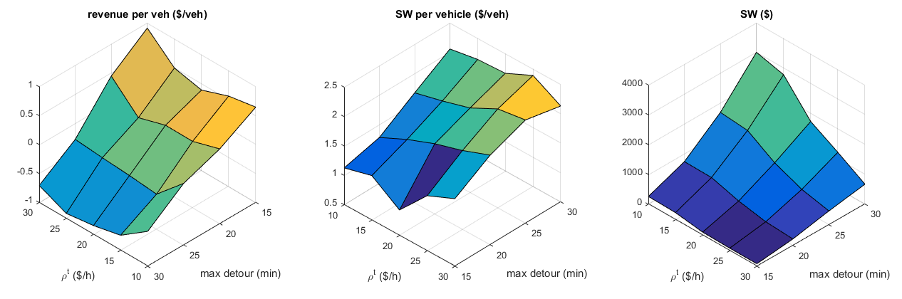

Providing Alternative Travel Options with Data & Model Driven Incentive Schemes for Smart Urban Mobility
UC, Irvine, Daisik Danny Nam
KOTAA Annual Meeting, Transportation Research Board 96th Annual Meeting, January, 2017
^{1.} A Model Based on Deep Learning for Predicting Travel Mode Choice
1. 17-06512
Tue 1:30 PM- 3:15 PM
2. 17-02556
Tue 1:30 PM- 3:15 PM
3. 17-06253
Wed 10:15 AM-12:00 PM
Daisik Nam, Hyunmyung Kim, Jaewoo Cho, R., Jayakrishnan
MLP model
The Proposed Deep Neural Network model (DNN-A)
2. Promoting Peer-to-Peer Ridesharing Services as Transit System Feeders
3. P2P Ridesharing With Ride-Back on HOV lanes:
Towards a Practical Alternative Mode For Daily Commuting
Neda Masoud, Daisik Nam, Jiangbo Yu, and R. Jayakrishnan
Roger Lloret-Batlle, Neda Masoud, and Daisik Nam
- Use of transit increases with the distance-based fare, since the transit fare is fixed
- Use of transit increases with VOT, which is expected, since the LA metro red line has a higher speed compared to the surrounding street network
- The matching algorithm is formulated as a min-cost max-flow problem which is exact and fast solvable on polynomial time.
- The mechanism modelling is based on the Vickrey-Clarke-Groves (VCG) mechanism

